Slide 1
Impedance Spectroscopy
Kitty Harris and Josh Eslarboukh

Slide 2
Phasor Notation

Slide 3
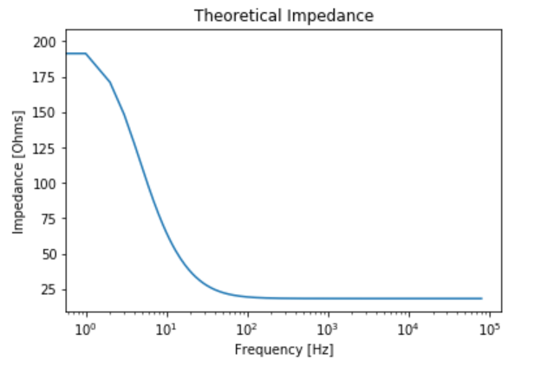


Frequency Dependence of Impedance
Impedance is a measure of how current flow is hindered in a system.
$Z_{series}=\sum_{i}{Z}$ and $\frac{1}{Z_{parallel}}=\sum_{i}{\frac{1}{Z}}$
$Z_{R}=R$ and $Z_{C}=\frac{1}{jωC}$
So, for our system under test, we end up with
$$Z={\left(\frac{1}{Z_{1}}+\frac{1}{Z_{2}}\right)}^{−1}={\left(\frac{1}{R_{1}}+\frac{1}{\frac{1}{jωC}+R_{2}}\right)}^{−1}=\frac{R_{1}\left(1+ω^{2}C^{2}R_{2}\left(R_{1}+R_{2}\right)−jωCR_{1}\right)}{1+ω^{2}C^{2}{\left(R_{1}+R_{2}\right)}^{2}}$$
As frequency approaches zero, the system behaves more like a DC circuit and charge cannot cross the branch containing the capacitor, so $Z≅R_{1}$.
As frequency becomes arbitrarily large, the current can arc across the capacitor, effectively ignoring its presence, and $Z≅\frac{R_{1}R_{2}}{R_{1}+R_{2}}$.

Slide 4
Lock-In Amplifier

Slide 5
Frequency Meter
A digital frequency counter measures frequency by taking counts of a periodic function over a set time period.
An oscillator (ex: quartz crystals) is placed inside the device

Slide 6
Prediction vs. Data

Slide 7
Curve Fitting

Slide 8
References
https://www.instructables.com/id/Digital-Frequency-Counter/

